Slide 1
CSE 320/EEE361 Data Communications
Digital Transmission
Chapter 4

Slide 2
Recap Previous Lecture
Digital data
Analog data
Digital Signal
Analog Signal
Digital Signal
Analog Signal

Slide 3
Encoding Techniques
Digital Data, Digital Signal
Less expensive and less complex than digital to analog modulation.
Digital Data, Analog Signals
Some transmission media, such as optical fiber and unguided media , will only propagate analog signals.

Slide 4
Digital Data 🡪 Digital Signal
Signal Encoding Techniques:
Line Coding
- Diffrent Line Coding Schemes
Block Coding
Scrambling
Line coding is always needed; block coding and scrambling may or may not be needed.

Slide 5
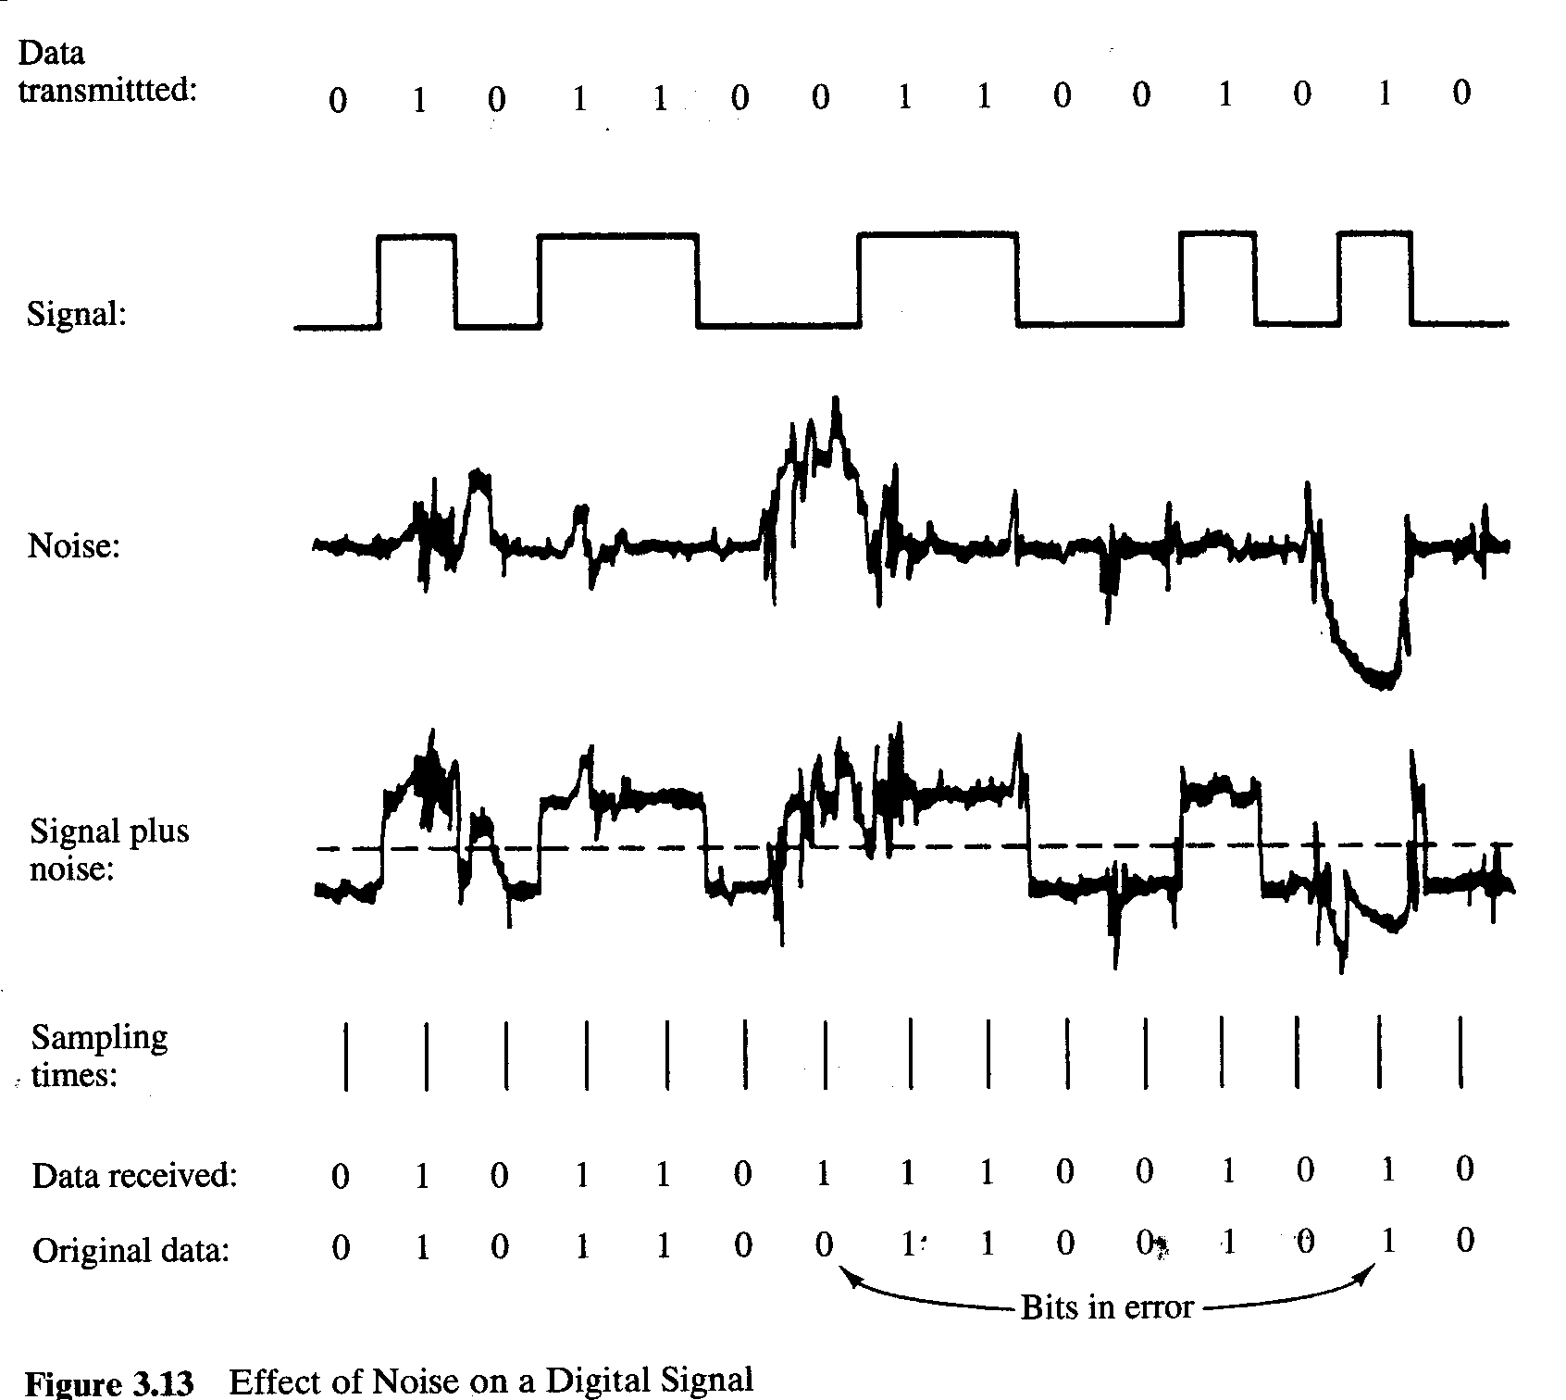
Digital Data, Digital Signal
Digital signal
Discrete, discontinuous voltage pulses
Each pulse is a signal element
Binary data encoded into signal elements

Slide 6
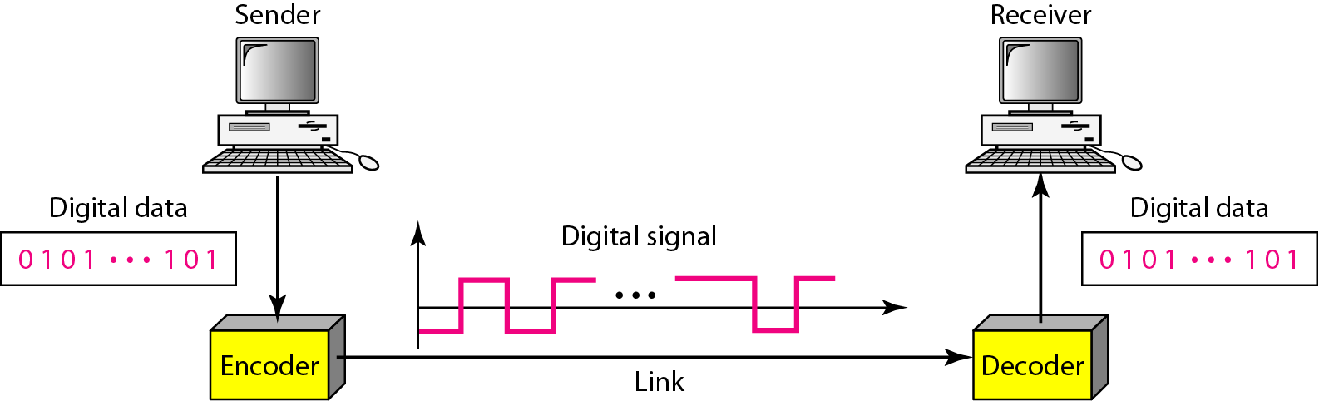
Line Coding
Line coding is the process of converting binary data, a sequence of bits, to a digital signal.

Slide 7
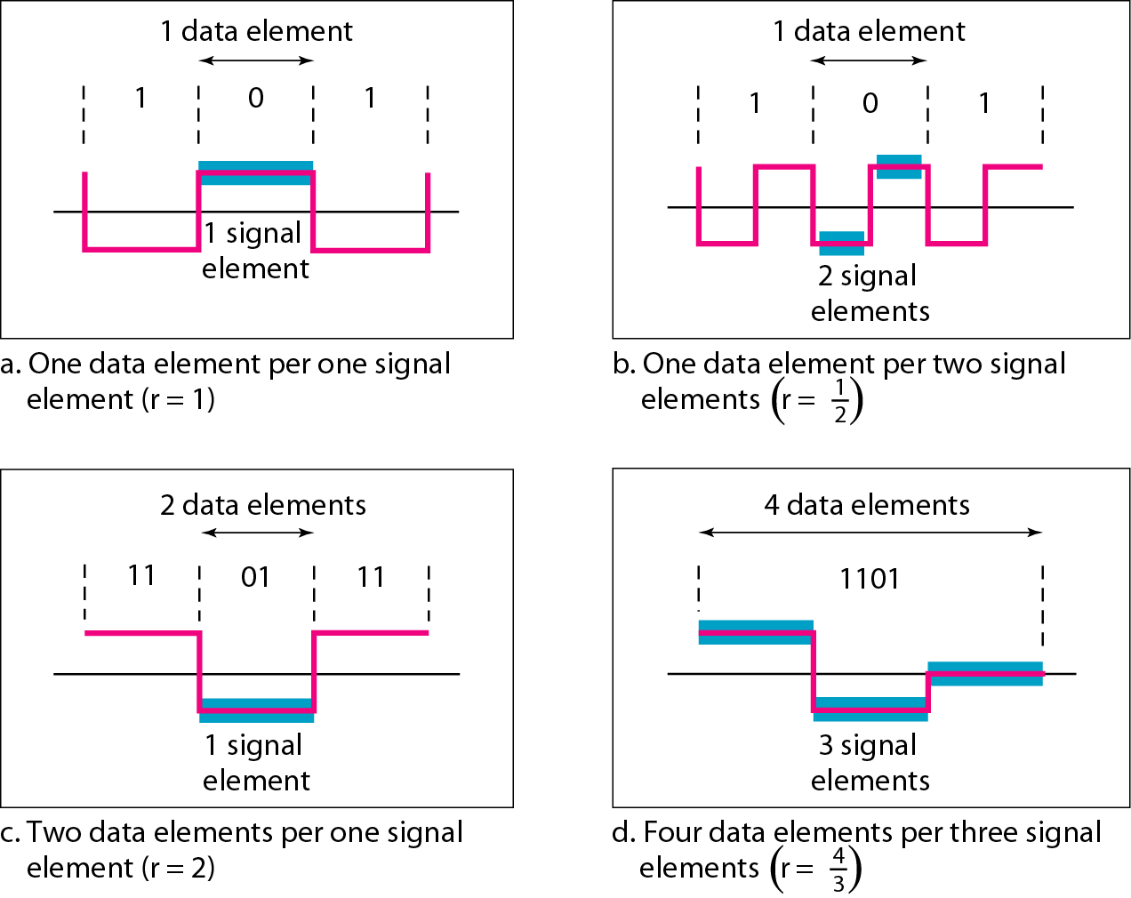
Signal Vs Data Element

Slide 8
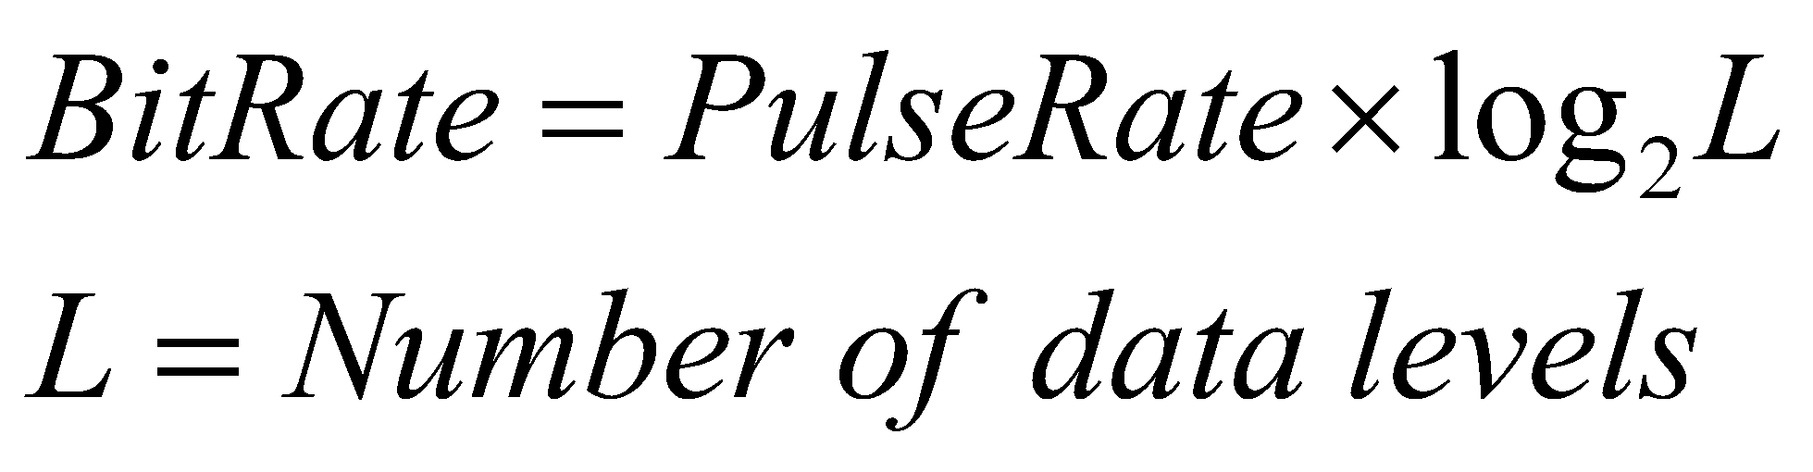
Pulse /Modulation /Signal/ Baud Rate versus Bit Rate
The pulse rate defines the number of pulses/signals sent in one second. Also known as Baud Rate.
The bit rate defines the number of bits per second.

Slide 9
Digital Data 🡪 Digital Signal
Receiver needs to know
Timing of bits
Signal levels
Factors affecting successful interpretation of signals
Baseline Wandering
DC Components
Self-synchronization
Built in Error Detection
Immunity to Noise and Interference
Complexity

Slide 10
BaseLine Wandering
Receiver calculates the running average of received signal power.
Average = baseline
A log strings of 0’s and 1’s can cause a drift in the baseline making it difficult for the receiver to decode properly.

Slide 11
DC Components
When the voltage level in a digital signal is constant for a while, the spectrum creates very low frequencies (results of Fourier analysis).
If the signal is to pass through a system (such as a transformer) that does not allow the passage of a dc component, the signal is distorted and may create errors in the output.
This component is extra energy residing on the line and is useless.

Slide 12
Self-Synchronization
The receiver’s bit intervals must correspond exactly to the senders bit intervals.
If the receiver clock is faster or slower, the bit intervals are not matched and the receiver might misinterpret the signals.

Slide 13
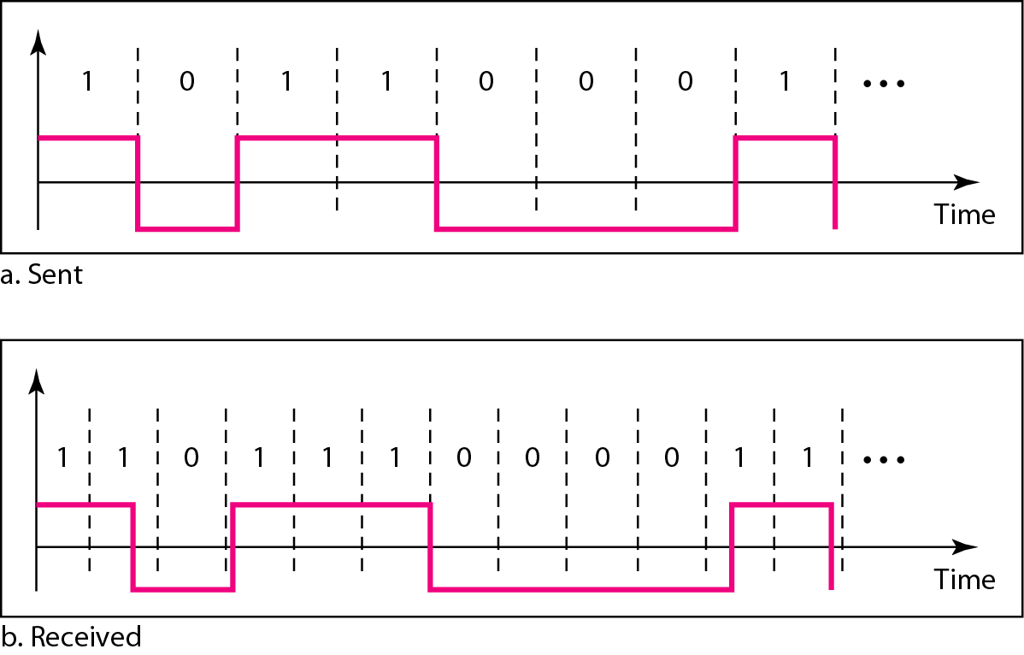
Figure 4.3 Effect of lack of synchronization

Slide 14
Self-Synchronization
A self-synchronizing digital signal includes timing information in the data being transmitted.
This can be achieved if there are transitions in the signal that alert the receiver to the beginning, middle, or end of the pulse.
If the receiver’s clock is out of synchronization, these points can reset the clock.

Slide 15
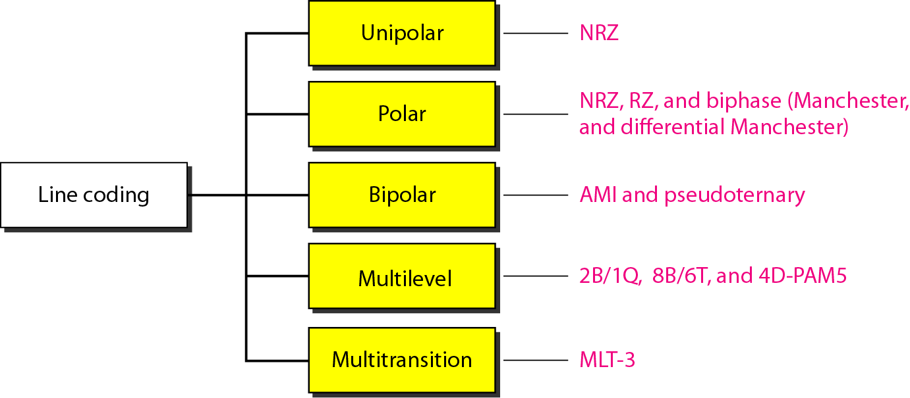
Different Line Encoding Schemes

Slide 16
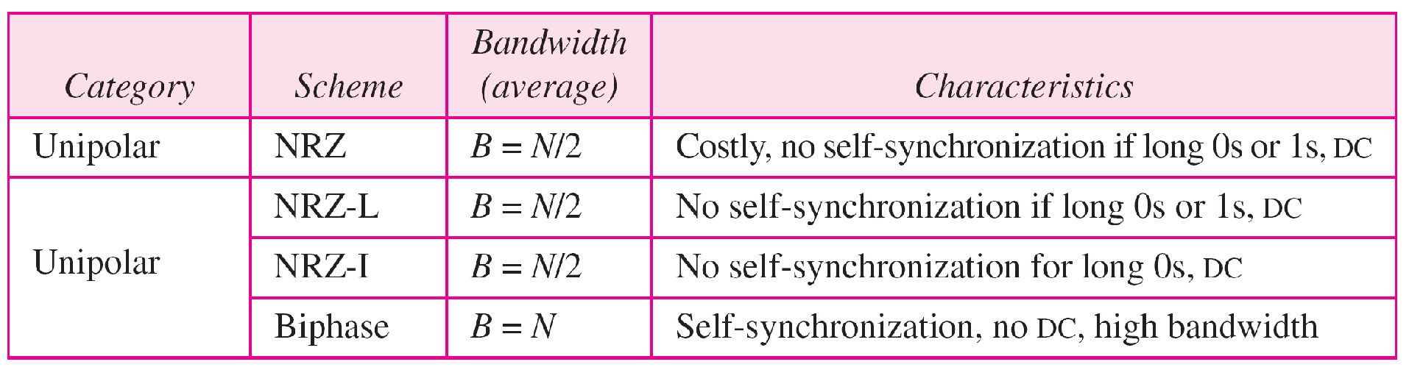
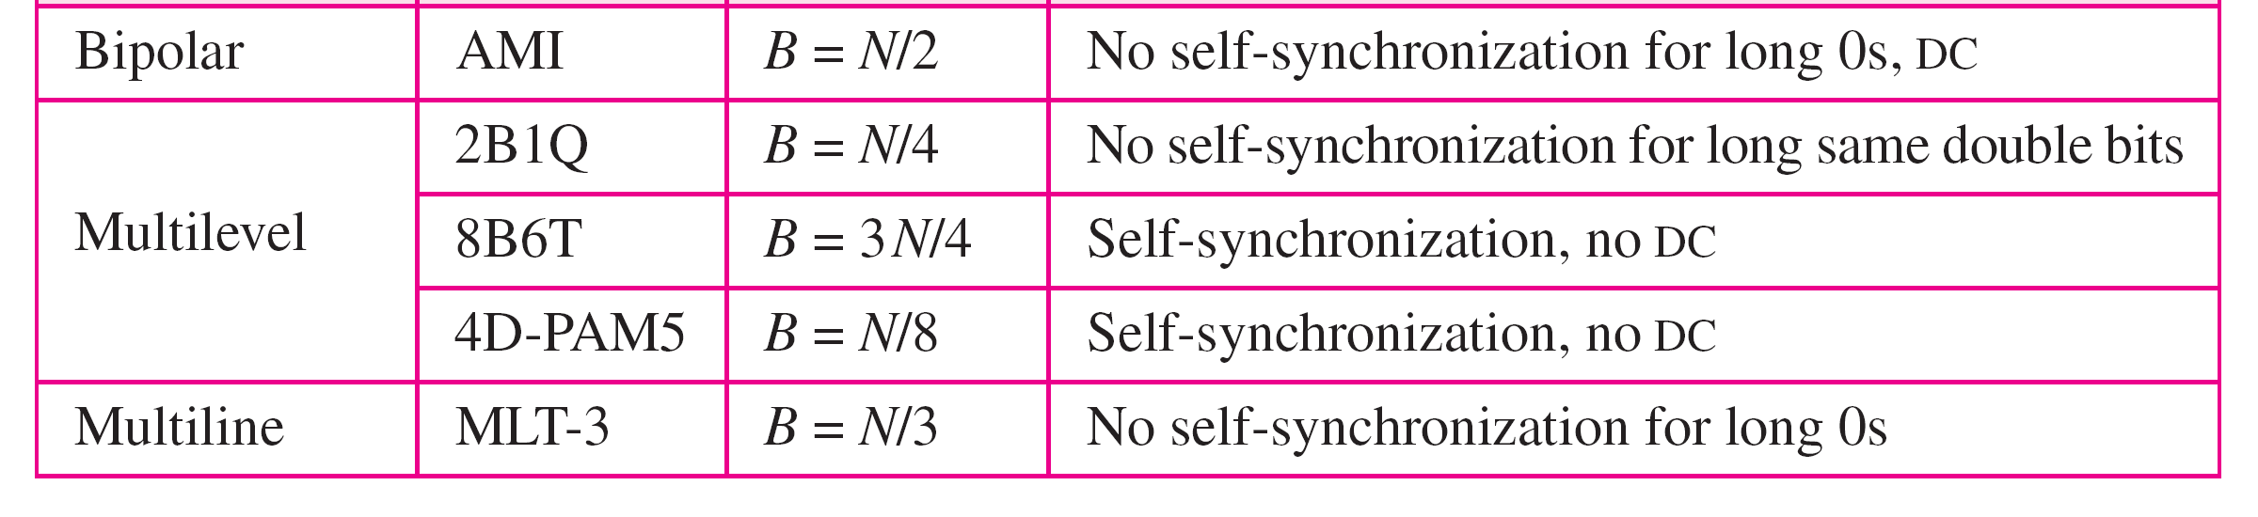
Table 4.1 Summary of line coding schemes

Slide 17
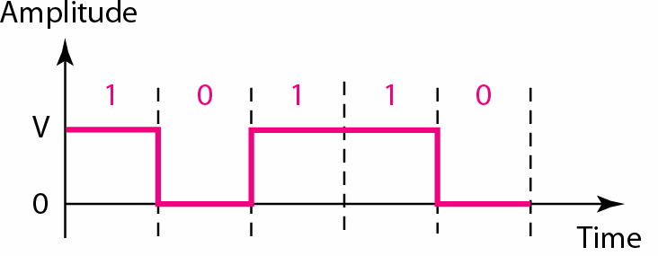
Unipolar

Slide 18
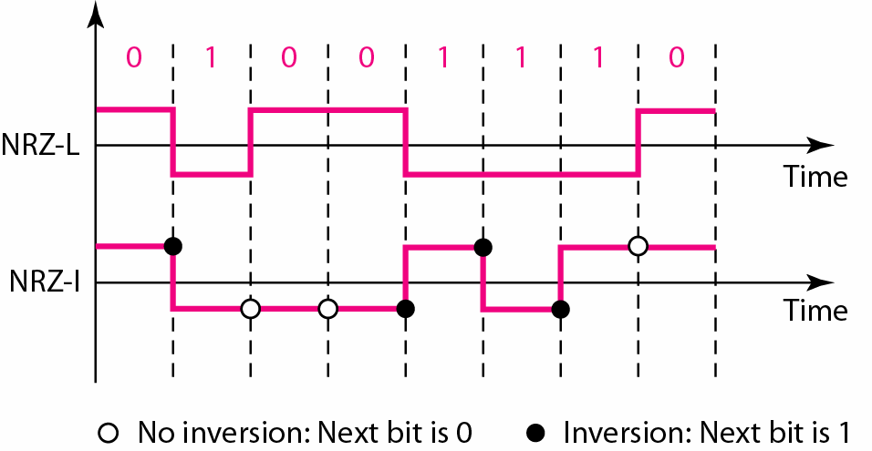
NRZ-L & NRZ-I (Bipolar)

Slide 19
Nonreturn to Zero (NRZ)
0 1 0 0 1 1 0 0 0 1 1
NRZ-L
NRZI
Notes:
NRZ
Two different voltages for 0 and 1 bits
Voltage constant during bit interval
No transition (i.e. no return to zero voltage)
Options:
1. Absence of voltage for zero, constant positive voltage for one
2. More often, negative voltage for one value and positive for the other
NRZI
Inverted on ones
Constant voltage pulse for duration of bit
Data encoded as presence or absence of signal transition at beginning of bit time
Transition (low to high or high to low) denotes a binary 1
No transition denotes binary 0
An example of differential encoding

Slide 20
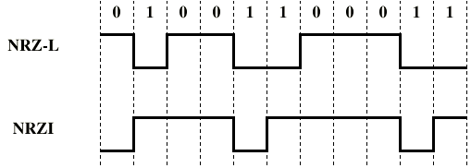
NRZ

Slide 21
NRZ – Pros and Cons
Pros
Easy to engineer
Make good use of bandwidth
Cons
DC component
Lack of synchronization capability
Used for magnetic recording
Not often used for signal transmission

Slide 22
Differential Encoding
In complex transmission layouts, it is easy to lose sense of polarity
Therefore
Data represented by changes (i.e., transitions) rather than levels
More reliable detection of transition rather than level

Slide 23
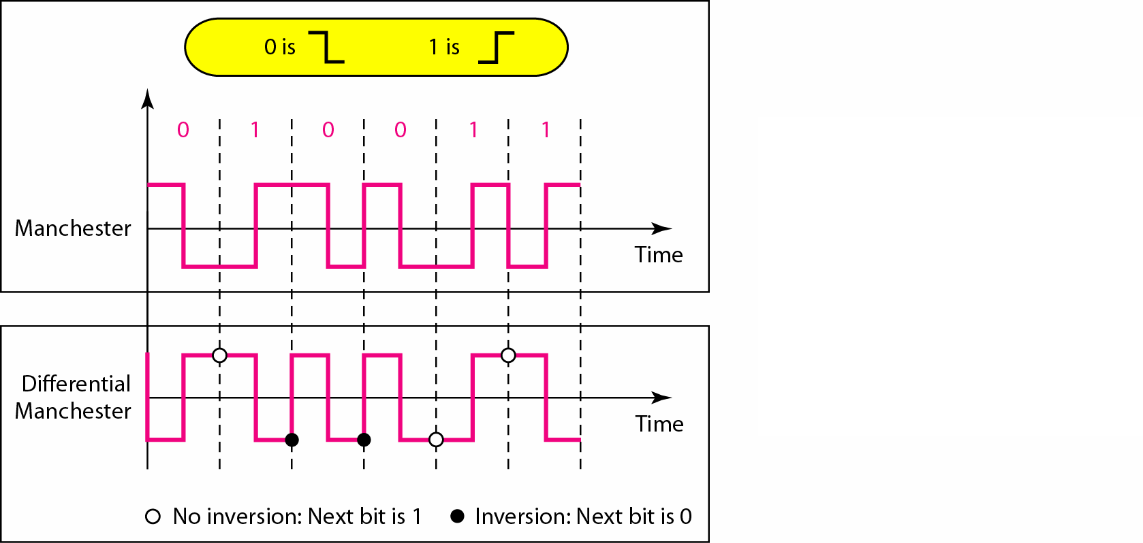
Manchester Encoding & Differential Manchester Encoding

Slide 24
Biphase (Manchester and D-Manchester)
0 1 0 0 1 1 0 0 0 1 1
Man
D-Man
Notes:
Manchester
Transition in middle of each bit period
Transition serves as clock and data
Low to high represents 1
High to low represents 0
Used by IEEE 802.3 (Ethernet LAN)
Differential Manchester
Mid-bit transition is clocking only
Transition at start of a bit period represents 0
No transition at start of a bit period represents 1
This is a differential encoding scheme
Used by IEEE 802.5 (Token Ring LAN)

Slide 25
Biphase -- Pros and Cons
Pros
Synchronization on mid bit transition (self clocking)
No dc component
Error detection
Absence of expected transition
Cons
At least one transition per bit time and possibly two
Maximum modulation rate is twice NRZ
Requires more bandwidth

Slide 26
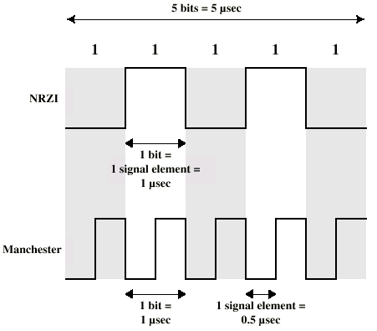
Modulation Rate

Slide 27
Multilevel Binary
Use more than two levels
Bipolar-AMI
zero represented by no line signal
one represented by positive or negative pulse
No loss of sync if a long string of ones (zeros still a problem)
Lower bandwidth

Slide 28
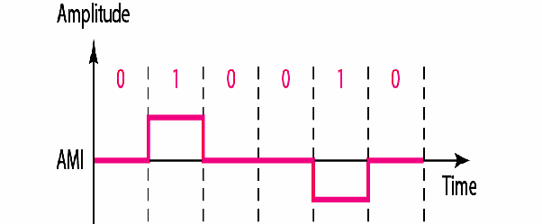
Bipolar-AMI

Slide 29
Multilevel Transition, three level- MLT-3,
There is no transition at the beginning of a 0 bit.
The signal transitions from one level to the next at the beginning of a 1 bit
Transition occurs using three levels of signals (+1, 0, -1).

Slide 30
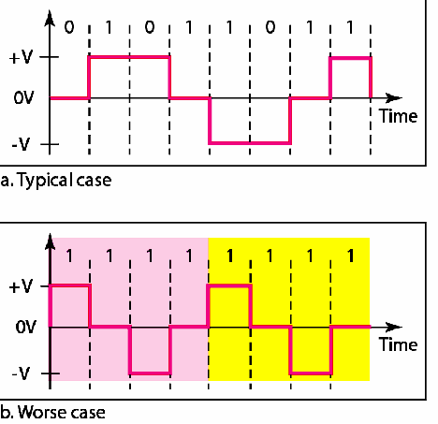
MLT-3

Slide 31
Biploar AMI and MLT-3 Example
0 1 0 0 1 1 1 0 0 1 1
Biploar
AMI
MLT-3
Notes:
Manchester
Transition in middle of each bit period
Transition serves as clock and data
Low to high represents 1
High to low represents 0
Used by IEEE 802.3 (Ethernet LAN)
Differential Manchester
Mid-bit transition is clocking only
Transition at start of a bit period represents 0
No transition at start of a bit period represents 1
This is a differential encoding scheme
Used by IEEE 802.5 (Token Ring LAN)

Slide 32
Block Coding

Slide 33
Block Coding/Scrambling
NRZ, Bipolar AMI, MLT-3 all has a common problem.
Long sequence of 0 can make the receiver lose synchronization
Solutions:
Change the bit stream before encoding with NRZ-I so that there is no long streams of 0s.

Slide 34
Solutions:
Block Coding
Scrambling
Block Coding
Changes a block of m bits to a block of n bits.
Referred to as mB/nB encoding.

Slide 35
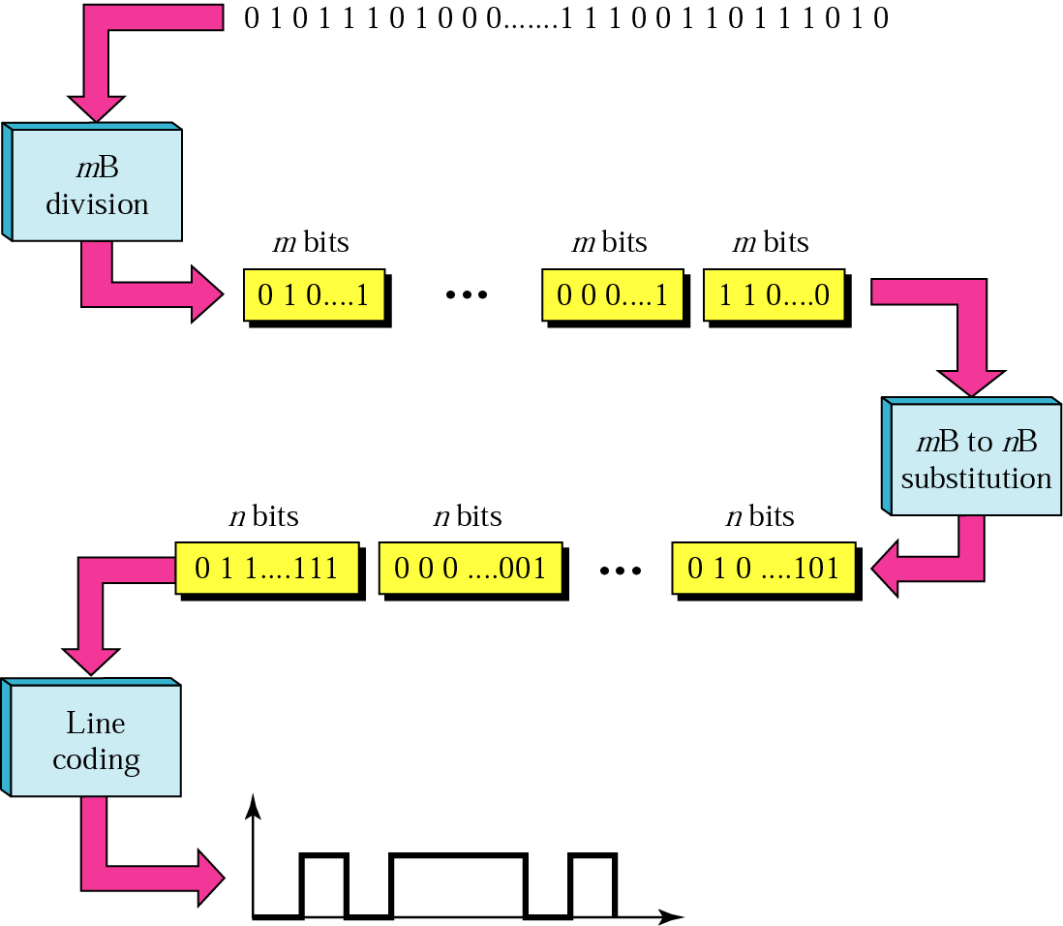
Block Coding
Three Steps Process:
Division
Substitution
Line Coding
/Combination

Slide 36
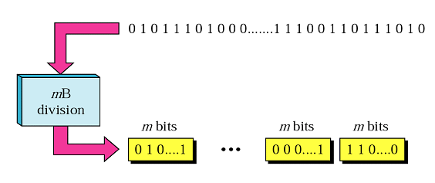
Step 1-Division
The sequence of bits in data in divided into m Bits.
For example in 4B/5B encoding, the original bit sequence is divided into 4-bit codes/sequence.

Slide 37
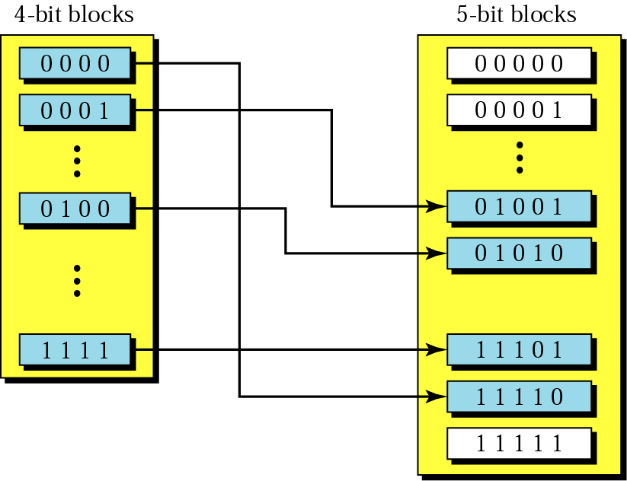
Step 2-Substitution
Each m bits sequence is substituted for a n bit code.

Slide 38
4B/5B Block Coding
4-bit code ==16 different combinations
5-bit code== 32 possible combinations.
So not all of 5-bit codes are required.
Selection of the 5-bit code is such that each code contains no more than
“one leading 0 and no more than two trailing 0s.” (3 consecutive 0s)

Slide 39
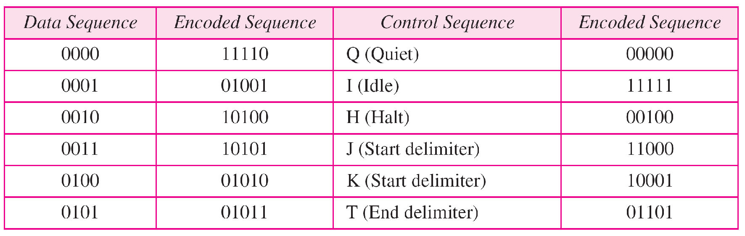
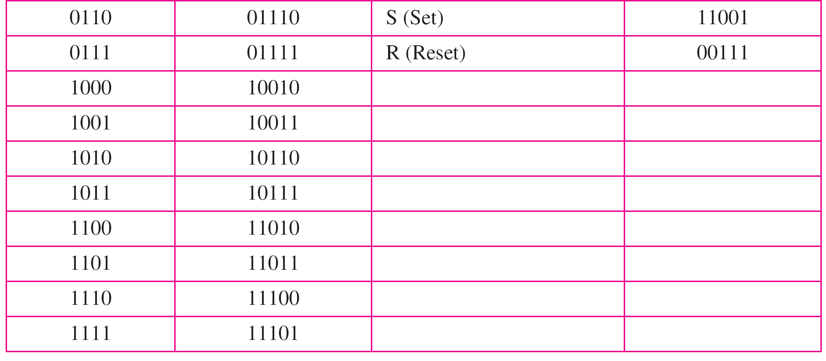
Table : 4B/5B encoding

Slide 40
Step 3: Line Coding
After substitution, a line coding scheme, exp NRZ-I is chosen to create a signal.
A very simple line coding scheme is chosen, because the block coding procedure provides
two desirable features (??) of complex line coding schemes.

Slide 41
Block Coding-Pros/Cons
Solves the synchronization problem but not the DC component problem.
If DC is unacceptable, use bipolar or biphase encoding.
Increases the baud rate by 20%, still better than Manchester schemes.

Slide 42
Scrambling
Use scrambling to replace sequences that would produce constant voltage
Filling sequence
Must be recognized by receiver and replace with original
Same length as original
Design Goals
No dc component
No long sequences of zero level line signal
No reduction in data rate
Error detection capability

Slide 43
Types of Scarmbling:
B8ZS
Bipolar With 8 Zeros Substitution
Commonly used US.
HDB3
High Density Bipolar 3 Zeros
Based on Bipolar AMI
Commonly used Europe and Japan.

Slide 44
B8ZS
Based on bipolar-AMI
If octet of all zeros and last voltage pulse preceding was positive encode as 000+-0-+
If octet of all zeros and last voltage pulse preceding was negative encode as 000-+0+-
Causes two violations of AMI code
Unlikely to occur as a result of noise

Slide 45
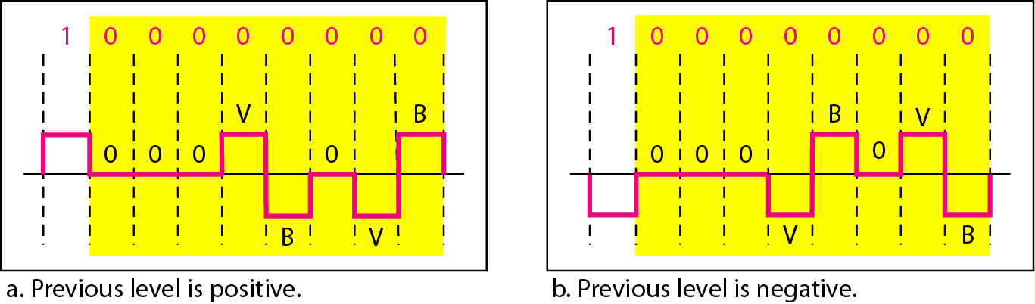
B8ZS

Slide 46
HDB3
High Density Bipolar 3 Zeros
Based on Bipolar AMI, Commonly used Europe and Japan.
Based on bipolar-AMI
String of four zeros replaced with one or two pulses

Slide 47

HDB3 Subtitution Table

Slide 48
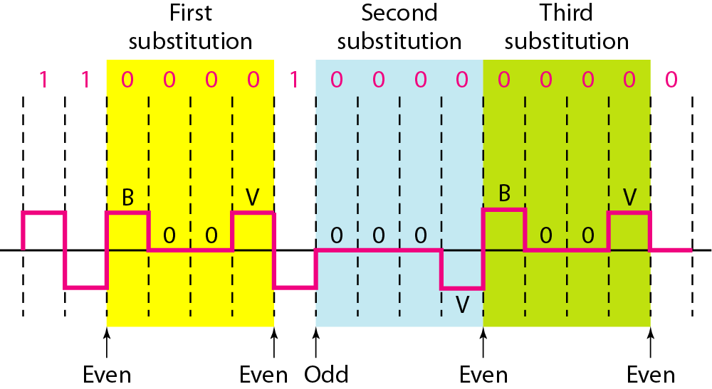
HDB3

